Slide 1
AFGE’s
Representation
Training

Slide 2
Course Materials
Participant Workbook
Steward Handbook
Title 5 U.S.C. Chapter 71

Slide 3
Course Objective
By the end of this course, you will be able to identify the various roles of a Steward, practice skills needed to perform your role effectively, and become aware of the resources available to help you be successful in your Union role.

Slide 4
What norms can we abide by in this learning community?

Slide 5
Introductions
Name
Local
Describe one (1) reason why you got involved with your Union

Slide 6

ROLE OF THE
UNION
ORGANIZING
(Internal and External)
REPRESENTATION
(Grievances, Meetings, Bargaining)
MOBILIZATION
(Community, Legislative, Political)

Slide 8
Knowledge and Resources
What Must a Steward Know?
What Materials Does a Steward Need?

Slide 9
Steward Best Practices

Slide 10
How To Be An Effective Steward
Know the employees you represent
Know how to use the Collective Bargaining Agreement, the Statute, and your Local Constitution and By-Laws.
Give pertinent information when a member asks for it.
Keep your fellow employees informed and let them know the source of your information.

Slide 11
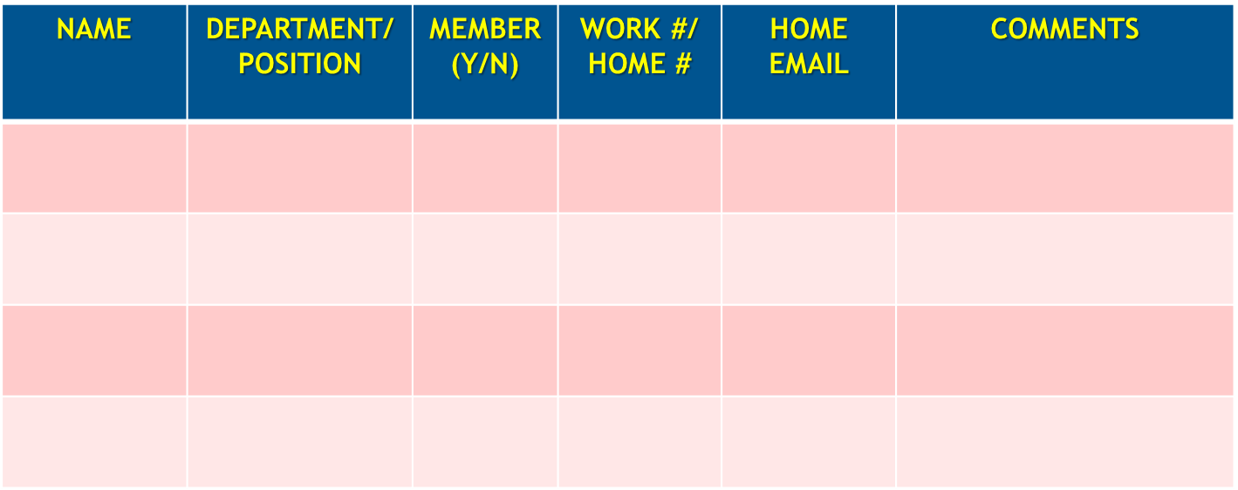
Work Group Roster

Slide 12

How To Be An Effective Steward
Meet new employees early, inform them, educate them, help them become members; get them to be active not just dues payers.

Slide 13
How To Be An Effective Steward
Tips for initial face-to-face contact
Make contact at the right time. (The sooner the better, preferably at a New Employee Orientation)
Introduce yourself.
Make eye contact.
Be polite, frank and don’t “preach”.
Listen to employee.

Slide 14
How To Be An Effective Steward
A Steward isn't expected to know all the answers, but must be the type of person who enjoys finding them.
Don't be afraid to ask questions, and to keep asking them.
If you have questions or problems, don't be afraid to use the phone or visit an experienced Steward or Officer.

Slide 15
How To Be An Effective Steward
Become known as someone who asks when you don't know, rather than someone who tries to bluff or hide.
Remember your goal is to be the best Steward or Activist that you can be. Always strive for this goal. Excellence has no substitute.

Slide 16
How To Be An Effective Steward
Be proud of your position and serve your members well.
As a Local representative you are affiliated with the support of tens of thousands of AFGE Union members.

Slide 17

AFGE ORGANIZATIONAL STRUCTURE
LOCAL UNION
Local
Constitution
Local President
Executive Board
Stewards
MEMBERS

Slide 18
AFGE ORGANIZATIONAL STRUCTURE
NATIONAL
REGIONAL
National
President
DISTRICT
National Vice President
AGENCY/
COMPONENT
Operations Departments
National Secretary Treasurer
National Representatives
WFP District Coordinators
Finance and Information Services Departments
COUNCILS
Council President
National Vice President for Women and Fair Practices
LOCALS
Local President
Local Executive Board
Council Executive Board
Stewards
Women’s and Fair Practices Departments
MEMBERS

Slide 19
NATIONAL CONVENTION
AFGE GOVERNING STRUCTURE
EXECUTIVE BOARD
National President
National Secretary Treasurer
National Vice President for Women and Fair Practices
AFGE
Constitution
National Vice Presidents
LOCALS
Local
Constitution
Local President
Local Executive Board
Stewards
MEMBERS

Slide 20


Slide 21
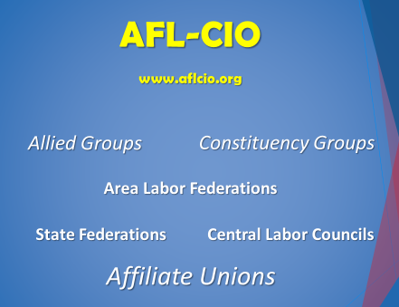

Slide 22
What do you say when….

Slide 23
A bargaining unit member comes up to you and says that he doesn’t ever want to join the Union because:
“Unions protect the lazy, the people who should be fired…”

Slide 24


Slide 25
The Civil Service Reform Act of 1978 led to the creation of Title 5 U.S. Code Chapter 71.
Agencies and Unions commonly refer to it as “the Statute” as it defines the legal framework for federal labor relations.

Slide 26
The Statute establishes the rules for:
Union representation
Information requests
Collective bargaining
Standards for labor organizations
Unfair Labor Practices (ULPs)

Slide 27
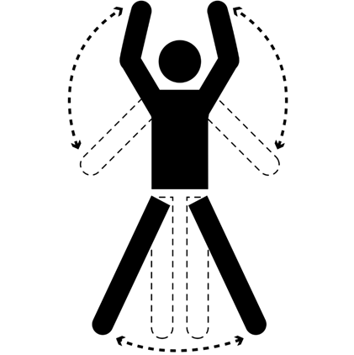
Exercise:
What’s in the Statute?

Slide 28
Learning Activity:
What’s in the Statute
Grab your Participant Workbook.
Research the assigned questions using the 5 USC Chapter 71 handout.
Write down the answer to your assigned question(s).
Identify the citation and the page number where the answer is located.
Summarize the answer whenever possible (use plain language and bullets)

Slide 29
1. Why did Congress enact a law establishing the right of employees to organize, bargain collectively, and participate in unions in the Federal Sector?
Citation: § 7101(a)

Slide 30
1. Why did Congress enact a law establishing the right of employees to organize, bargain collectively, and participate in unions in the Federal Sector?
Safeguards the public trust
Contributes to effective public business
Facilitates and encourages settlement of disputes

Slide 31
2. What rights do employees have?
Citation: § 7102

Slide 32
2. What rights do employees have?
To form, join, or assist any labor organization, or to refrain, freely and without fear of penalty or reprisal.
To act for a labor organization in the capacity of a representative and to present the views of the labor organization
To engage in collective bargaining

Slide 33
3. What is a “grievance”?
Citation: §7103(a)(9)

Slide 34
3. What is a “grievance”?
Any complaint –
by an employee concerning any matter relating to the employment of the employee;
by any labor organization on any matter relating to the employment of any employee; or the effect or interpretation, or a claim of a breach of the CBA; or affecting conditions of employment;
by any employee, labor organization, or agency concerning –
  the effect or interpretation, or a claim of breach, of a CBA; or law, rule or applicable regulation.

Slide 35
4. What is a “collective bargaining”?
Citation: § 7103(a)(12)

Slide 36
4. What is a “collective bargaining”?
Performance of the mutual obligation of the representative of an agency and the exclusive representative…to meet at reasonable times and to consult and bargain in good faith effort to reach agreement with respect to the conditions of employment…. and to execute…. a written document incorporating any collective bargaining agreement (CBA) but this does not compel either side to agree to a proposal or make a concession…

Slide 37
5. What are 3 examples of a “conditions of employment”?
Citation: § 7103(a)(14)

Slide 38
5. What are 3 examples of a “condition of employment”?
Personnel policies
Personnel practices
Personnel matters

Slide 39
6. List 4 rights the Agency does not have to negotiate with
the Union:
Citation: § 7106(a)

Slide 40
6. List 4 rights the Agency does not have to negotiate with
the Union:
Determine the mission, budget, organization, number of employees and internal security practices
Hire, assign, direct, layoff, retain and discipline
Assign work, contract out
Take action during emergencies

Slide 41
7. List 3 items the Union can negotiate with the Agency:
Citation: § 7106(b)

Slide 42
7. List 3 items the Union can negotiate with the Agency:
Permissive topics:
At the election of the agency – number, types, and grades of employees or positions assigned or the technology, methods, and means of performing work
Impact and implementation (I & I):
Procedures which management officials observe in exercising any authority
Appropriate arrangements for employees adversely affected by the exercise of any authority by management officials.

Slide 43
8. Who is the Union required to represent and negotiate for:
Citation: §7114(a)(1)

Slide 44
8. Who is the Union required to represent and negotiate for:
All employees in the bargaining unit, whether or not they are members of the Union. (Duty of Fair Representation)

Slide 45
9. When must the Agency provide
the Union with the opportunity
to represent employees:
Citation: §7114(a)(2)

Slide 46
9. When must the Agency provide the Union with the opportunity to represent employees:
1. Any formal discussion between one or more representatives of the agency and one or more employees in the unit or their representatives concerning any grievance or any personnel policy or practices or other general condition of employment.
(7114(a)(2)(A) = Formal Meeting)

Slide 47
9. When must the Agency provide the Union with the opportunity to represent employees:
2. Any examination of an employee in the unit by a representative of the Union in connection with an investigation if –
  the employee reasonably believes that the examination may result in disciplinary action against the employee; and
  the employee requests its representation
(7114(a)(2)(B) = Weingarten Meeting)

Slide 48
10. Describe 2 requirements for “good faith” negotiations:
Citation: §7114(b)

Slide 49
10. Describe 2 requirements for “good faith” negotiations:
Approach negotiations with a sincere resolve to reach agreement
Be prepared to discuss and negotiate on any condition of employment.
Meet at reasonable times and places as frequently as necessary and to avoid unnecessary delays.

Slide 50
10. Describe 2 requirements for “good faith” negotiations:
In the case of the agency, furnish data to the union upon request and to the extent not prohibited by law (request for information):
  Data which is normally maintained by the agency in the regular course of business
  Reasonably available and necessary for full and proper discussion, understanding and negotiation of subjects within the scope of bargaining, and
  Which does not constitute guidance, advice, counsel or training provided for management officials or supervisors, relating to collective bargaining

Slide 51
10. Describe 2 requirements for “good faith” negotiations:
If an agreement is reached, to execute on the request of any party to the negotiation a written document embodying the agreed terms and to take such steps as necessary to implement such agreement.

Slide 52
11. Describe 2 actions that would be an Unfair Labor Practice (ULP) by the Agency:
Citation: §7116(a)

Slide 53
11. Describe 2 actions that would be an Unfair Labor Practice (ULP) by the Agency:
To interfere, restrain, or coerce any employee in the exercise of any right under this chapter
To encourage, discourage membership in any labor organization by discrimination in hiring, tenure, promotion or other conditions of employment
to sponsor, control, or otherwise assist any labor organization

Slide 54
11. Describe 2 actions that would be a ULP by the Agency:
to discipline or otherwise discriminate against an employee because the employee has filed a complaint, affidavit, or petition, or has given any information or testi­mony under this chapter;

Slide 55
11. Describe 2 actions that would be a ULP by the Agency:
to refuse to consult or negotiate in good faith as required
to fail or refuse to cooperate in impasse procedures and decisions as required
to enforce any rule or regulation in conflict with an applicable collective bargaining agreement
if the agreement was in effect before the rule or regulation
to other fail or refuse to comply with the Statute.

Slide 56
12. What is the primary document for grievance & arbitration:
Citation: §7121(a)

Slide 57
12. What is the primary document for grievance & arbitration:
The Collective Bargaining Agreement (CBA) between the Agency and the Union.

Slide 58
Roles, Rights, and Resources
A member tells you that she and 3 other employees are always coughing and sneezing at work. She says their symptoms get better when they are out of the office.
All of the employees work in a mold-infested office that has not been renovated for years.

Slide 59
Roles, Rights, and Resources
What type of problem is the employee raising?
What actions can you take as a Steward to help?
What rights do you have under the Statute to help these members?
What resources are available to help with this situation?

Slide 60




Which Hat Do You Identify With and Why?

Slide 61
Steward’s Roles
Worksite Leader
Educator & Communicator
Organizer
Legislative & Political Activists
Problem Solver

Slide 62
Attitude Reflects Leadership https://www.youtube.com/watch?v=guA_4AzXqh0

Slide 63
Attitude Reflects Leadership
Julius asks Gerry if, as a Captain, he was also a leader and Gerry says yes. Do you agree with this? Why or why not?
Julius has a bad attitude about the team; is this a reflection or poor leadership?
What can you do to be a leader?
How can you manage your attitude during challenging times?

Slide 64
Challenges of Leadership Scenarios
Challenges of Leadership Scenarios

Slide 65
Scenario 1: You are the chairperson of your local’s membership committee. You just found out that one of the other members of your committee got caught signing up a member on duty time. The committee member, during a meeting of the committee, disrupts the meeting and loudly tells you that you don’t have the guts to do what he did. How might you deal with that person?

Slide 66
Scenario 2: You’ve been asked by your local president to serve on your local’s bargaining committee. While planning your local’s proposals, an argument arises between two members of the committee. The argument concerns whether to propose a 4-10 or 5-4-9 compressed work schedule arrangement. What might you do to help resolve the issue and involve the disagreeing team members in the process?

Slide 67
Scenario 3: You’ve been appointed by your local’s president to chair a labor and management health and safety problem-solving committee. One of the local’s other Stewards comes to you and complains that he was not considered for the committee despite the fact that he has been interested in health and safety issues for years. He’s concerned that some of the members of the committee are “Johnnie come lately” members who seem to be getting better treatment than long-time activists. As a local leader, how might you respond?

Slide 68
Scenario 4: You are the chairperson of the local’s Legislative Action Fund Committee. As a result of your committee’s actions, the local has been awarded a LAF certificate for its participation in the program. During a regular meeting of the local, and much to your surprise, the president calls you to the front of the room and praises your leadership of the committee. The local president turns to the membership and asks for a round of applause. How might you, as an effective leader, deal with that situation?

Slide 69
Steward Leadership Traits
Listening to others
Making others feel important
Promoting a vision
Following the “Golden Rule”
Admitting mistakes
Criticizing others only in private
Staying close to the action

Slide 70

Problem Solver

Slide 71
Problem Solver
Identify the requirements of a formal meeting
Determine when a situation involves Weingarten Rights
Describe process and requirements for handling a grievance
Discuss the basic criteria for an information request

Slide 72
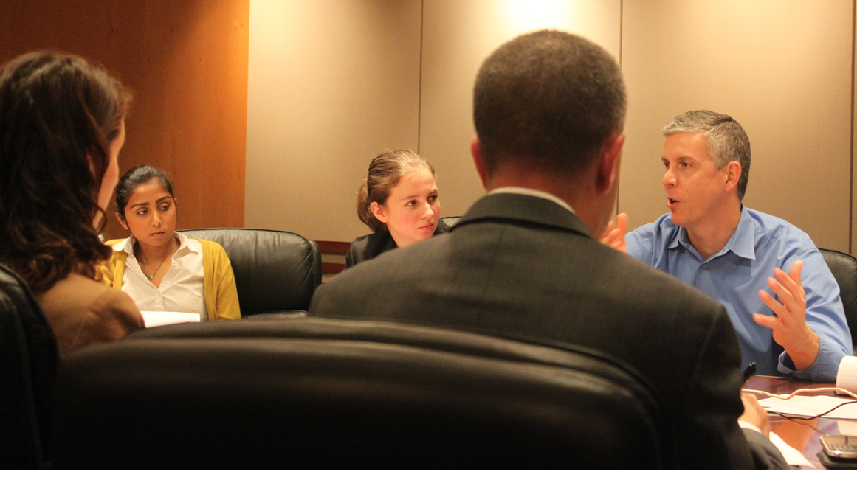
Formal Discussions

Slide 73
Formal Discussions
Criteria for a Formal Discussion:
  Who is involved in the meeting?
  Was there a “give and take” - were
  questions addressed?
  Did the meeting concern ‘conditions of employment’?
  Did the meeting concern a grievance?

Slide 74
Formal Discussions
Union’s Rights at a Formal Discussion
  Asking questions related to matters under discussion at the meeting
  Making relevant remarks concerning those matters
  Stating the Union’s position(s) on the matters under discussion

Slide 75
How Formal is this Discussion?

Slide 76
Terry’s office is short-staffed because of a recent large turnover of employees. As the Steward for the office, he has expressed concern about the matter and manager promised new employees were to be hired for the entry-level jobs. Last week, three new employees showed up. A couple of days later, Terry overheard the new employees in the supervisor’s office being briefed about parking policy, leave request issues, and frequency of performance ratings.
Formal Discussions: Yes or No?

Slide 77
Susan is a Steward who works with David. David has requested a meeting with the supervisor to review claims processing procedures since he’s having trouble doing them correctly. Susan passes the supervisor’s office and sees David being “walked-through” the claims process by the supervisor.
Formal Discussions: Yes or No?

Slide 78
One of the employee’s in Terry’s office has filed a grievance, without his assistance, over an annual leave denial. One afternoon, Terry passes the supervisor’s office and hears him discussing the leave issue with the employee.
Formal Discussions: Yes or No?

Slide 79
Dawn is representing an employee in a performance appraisal grievance. The grievance wasn’t resolved and is scheduled for hearing at arbitration. Two weeks before the hearing, the grievant, Robert, tells Susan that the agency’s attorney called him. Robert tells Susan the attorney asked about his performance and said from what he knew he wasn’t that good a worker. He also told him that his case looked “weak.” Robert says the agency’s attorney was rude to him and he wants Susan to speak with him about being more considerate.
Formal Discussions: Yes or No?

Slide 80
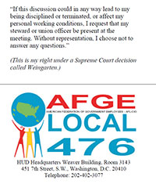
Investigatory Examinations(Weingarten Rights)

Slide 81
OPEIU/Washington Council of Labor
Training on Weingarten
https://youtu.be/s8gmmx9eXI?list=PLBBBwx0b96b6x6tboZEbTVWplu7rhPQZs

Slide 82
FLRA Factors
Problem Solver – Weingarten Rights
  The following factors determine if a meeting is an investigatory examination:
  Designed to ask questions and solicit information from the employee
  Conducted in a confrontational manner
  Designed to secure an admission from the employee of wrongdoing
  Requires the employee to explain his/her conduct

Slide 83
Investigatory Examination
(Weingarten) Rules
Problem Solver – Weingarten Rights
Rule 1:
  Investigatory examination
Rule 2:
  Grant and delay
  Deny and end
  Give a choice
    Continue without representation or end the interview

Slide 84
Weingarten Rules
Problem Solver – Weingarten Rights
Rule 3: Refusal to honor the request =
Unfair Labor Practice (ULP)

Slide 85

Weingarten or Not
Problem Solver – Weingarten Rights

Slide 86
Weingarten or Not
Problem Solver – Weingarten Rights
Last week, Malcolm had a verbal disagreement with his manager over an assignment. While he was walking to his desk today after lunch, the supervisor called Malcolm into his office to discuss the incident.
During the course of the conversation, Malcolm asks for a Union Representative to attend the meeting. The supervisor refuses. Is this a violation of his Weingarten Rights?
What if anything should Malcolm do?

Slide 87
Weingarten or Not
Problem Solver – Weingarten Rights
John is called into the supervisor’s office for a discussion of his work performance. John’s Steward is out sick so John asks that the interview be delayed until his Steward returns.
Is John entitled to representation? Does management have to wait until the requested Steward/Representative returns to work? Explain.

Slide 88
Weingarten or Not
Problem Solver – Weingarten Rights
You, an employee who happens to be a Union Steward, are called into the office to discuss an incident that occurred between you and between you and another employee.
Are you entitled to union representation under the Statute?
Why or why not?

Slide 89
Weingarten or Not
Problem Solver – Weingarten Rights
Jane is called to her supervisor’s office and questioned about a fight she witnessed between two other co-workers in her area.
Is Jane required to have Union representation?
Explain.

Slide 90
LUNCH TIME!

Slide 91
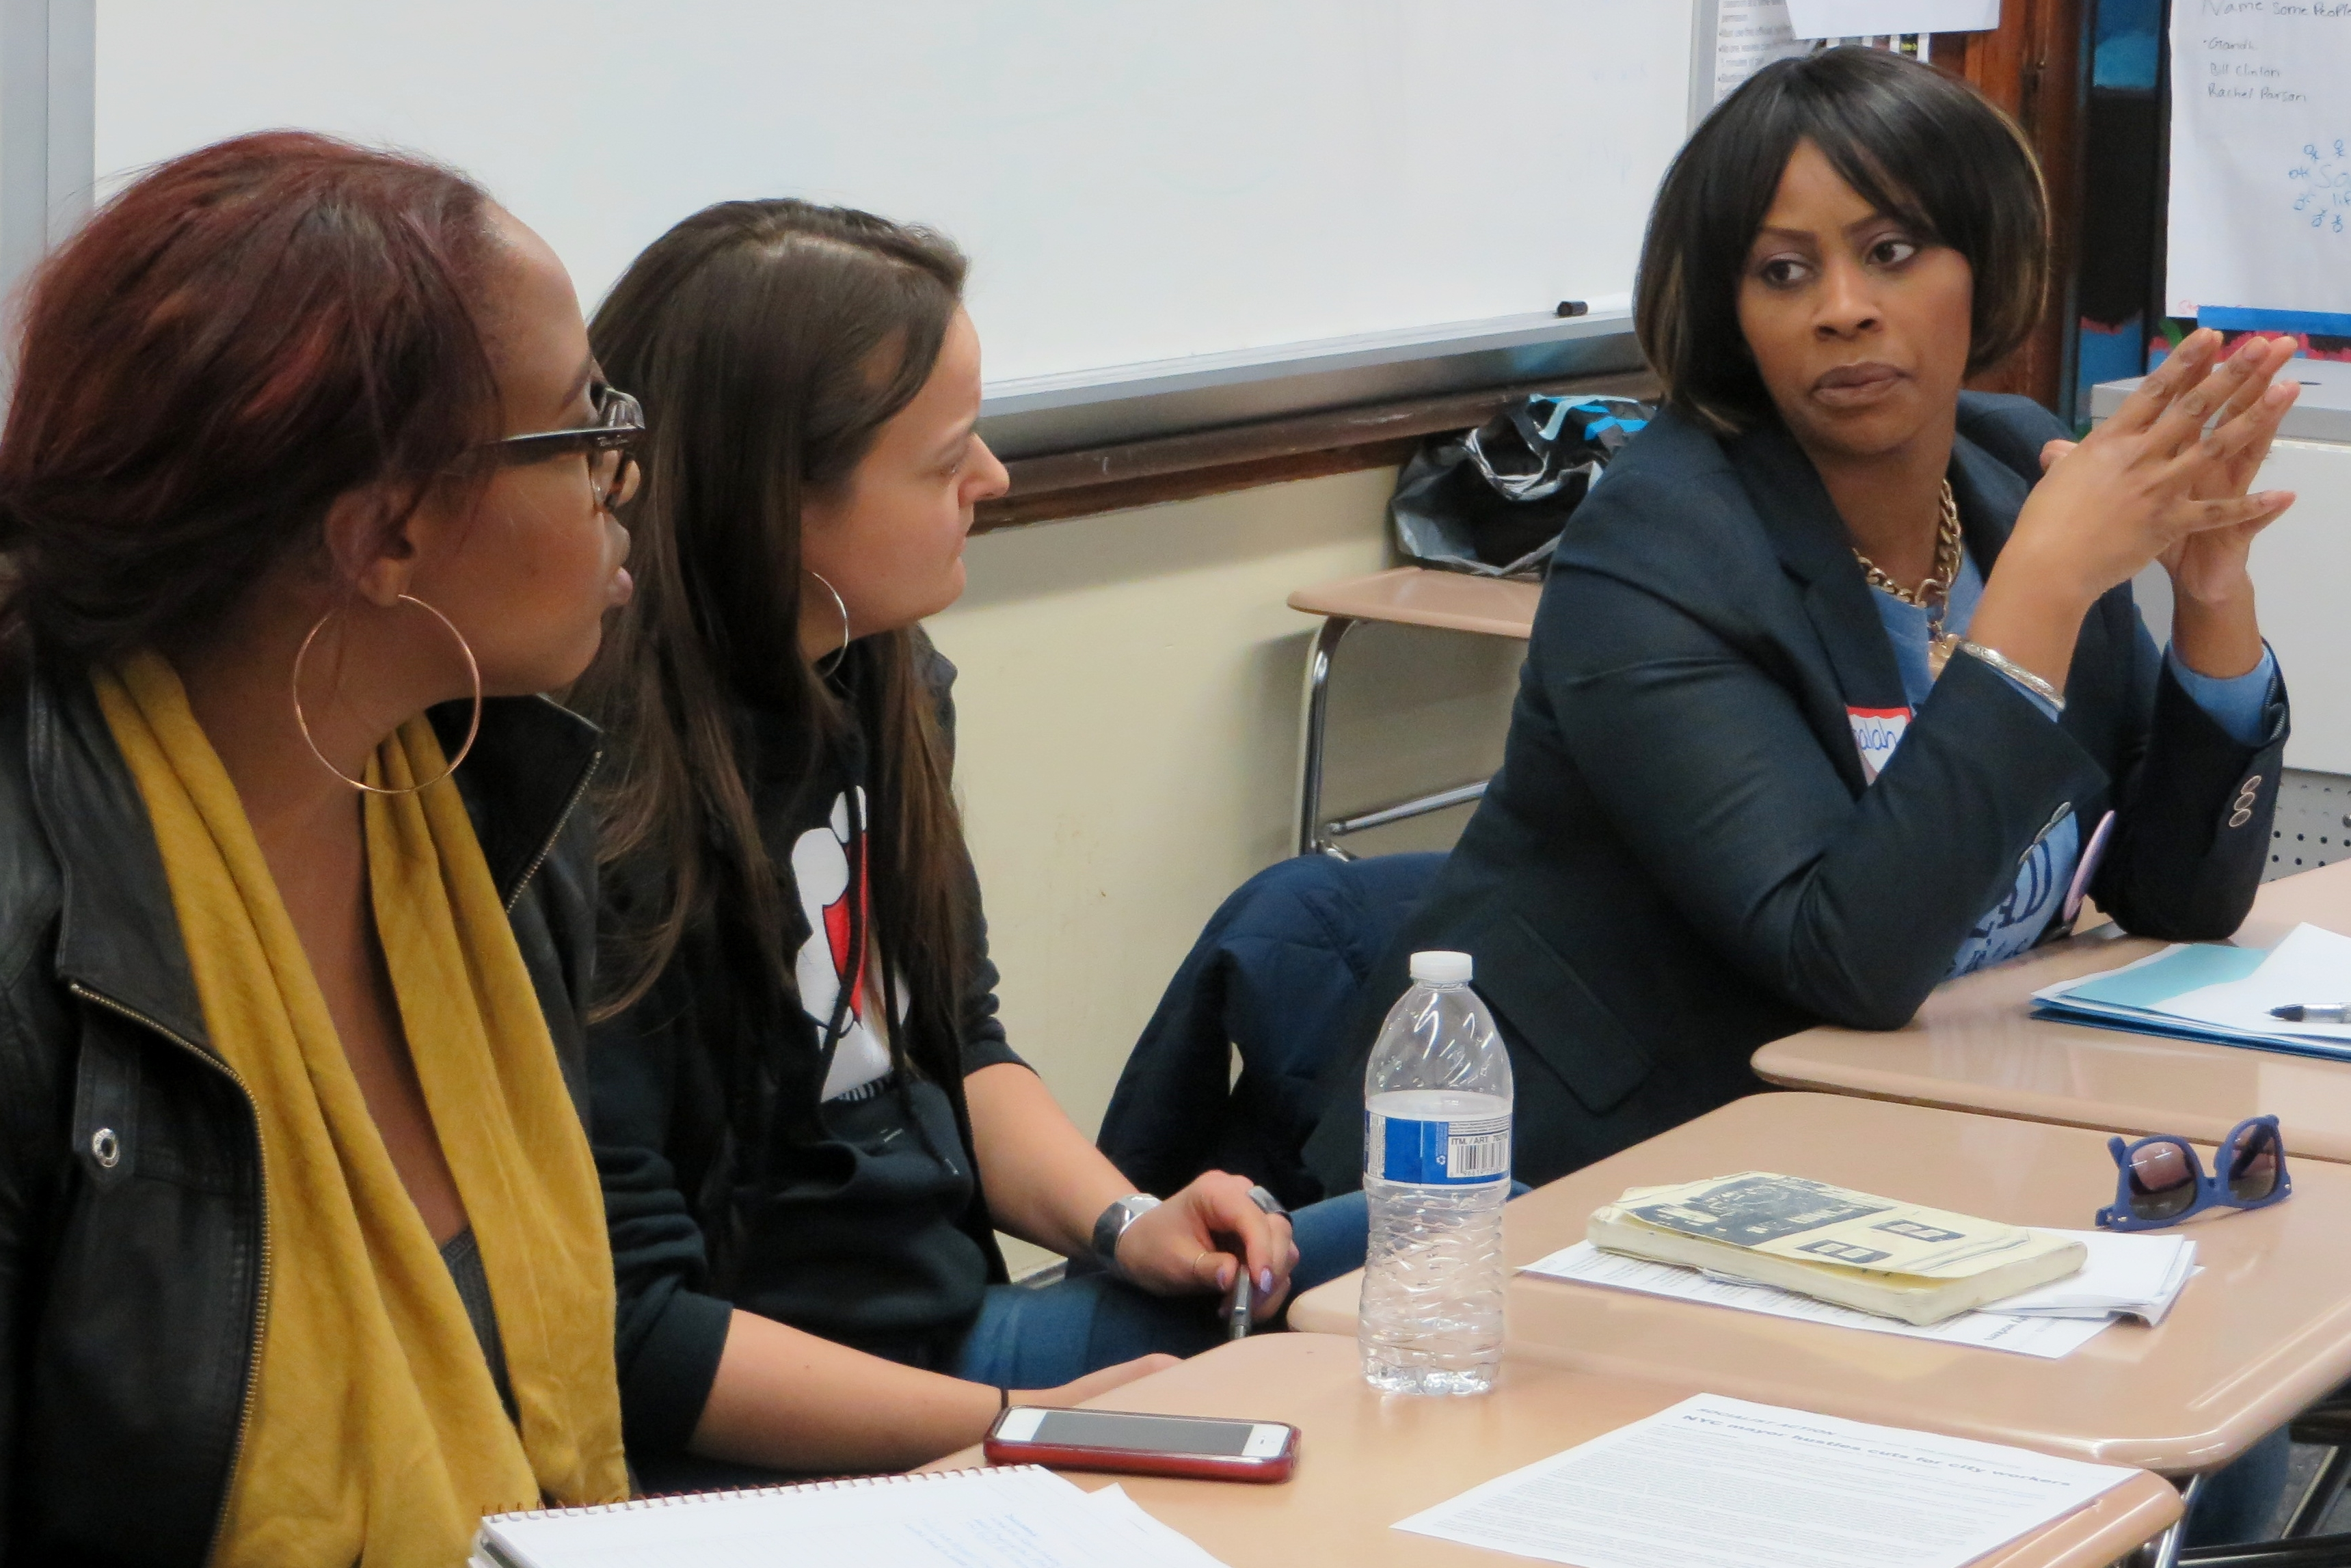
GRIEVANCES

Slide 92
Grievances Defined
Complaint by:
  Employee
  Union
  Agency

Slide 93
Grievances Defined
Any matter relating to employment
Effect, interpretation, or claim of breach, of a collective bargaining agreement
Law, rule or applicable regulation

Slide 94
A Grievance Cannot Concern:
Any claimed violation of Subchapter II of Title 5, United States Code (pertaining to prohibited political activities);
Retirement, life insurance, or health benefits;
Suspension or removal under Section 7532 of Title 5, United States Code (concerning national security);

Slide 95
A Grievance Cannot Concern:
Any examination, certification, or appointment.
Classification of any positions (does not result in the reduction in grade or pay of an employee)
Any other matter the parties have agreed to exclude.

Slide 96
5 USC Chapter 71 Subchapter III:
Negotiated Grievance Procedure requirements:
Fair and simple
Provide for expeditious processing
Assure the union the right to present and process grievances
Assure the employee the right to present a grievance and assure the Union’s right to be present during the proceeding.

Slide 97
5 USC Chapter 71 Subchapter III:
Negotiated Grievance Procedure requirements:
Assure the employee the right to present a grievance and assure the Union’s right to be present during the proceeding.
Provide that any grievance not satisfactorily settled shall be subject to binding arbitration that can be invoked by either the Union or the Agency.

Slide 98
Issues may be raised under the grievance procedure or as an unfair labor practice, but not under both procedures.
5 USC 7116(d)

Slide 99

Complaint, Grievance or ULP

Slide 100
Complaint, Grievance or ULP
Robert comes to you to complain that he was injured on the job and the Workers Compensation program denied him benefits.
Does he have a grievance? Why or why not?

Slide 101
Complaint, Grievance or ULP
As the Union Representative, you were denied official time to organize a lunch and learn.
Is this a grievance? Why or why not?

Slide 102
Complaint, Grievance or ULP
Cynthia recently requested a temporary telework schedule to provide elderly care for her mother who just got out of the rest home. Her request was denied and she wants to file a grievance.
Is this a grievance? Why or why not?

Slide 103
Complaint, Grievance or ULP
Jessie comes to you to complain that a manager just sexually harassed her. She went to the EEO counselor but was told that it would take years to get a hearing. She wants the union to file a grievance now.
Is this a grievance? Why or why not?

Slide 104
Complaint, Grievance or ULP
You just received a letter from the agency that effective in two weeks; they are going to stop subsidizing the monthly parking fee.
Is this a grievance? Why or why not?

Slide 105

Your Grievance Procedure

Slide 106
Grievance Handling Model
Identification
Investigation
Documentation
Preparation
Presentation

Slide 107
1. Identification
Violation (e.g., CBA, policy, rule, regulation)
Time limits
Past Practice

Slide 108
Past Practice
Existing practices sanctioned by use and acceptance that are not specifically included in the CBA.

Slide 109
Past Practice
Clear and consistent course of action
Reasonable duration
Full knowledge
Contract is silent or ambiguous
Employee harmed by change of practice (Union must show)

Slide 110
2. Investigation
Talking to the right person/people
5 W’s
Standardized Form
Follow up

Slide 111
3. Documentation
Physical Evidence
Particularized Need
    Why
    How
    Relevancy

Slide 112
Particularized Need
Information requested must be:
Normally maintained in the regular
course of business by the Agency
Reasonably available
Necessary

Slide 113
Particularized Need
Union cannot request information that is:
Under the Privacy Act
Collective bargaining guidance, advice,
counsel, or training for management
Prohibited by other laws

Slide 114

Getting the Information

Slide 115
Getting the Information
Consider the facts presented and decide if the situation would require the agency to provide the requested information.
Situation 1: Several members of your Local have come to you with concerns about the way the city bus lines are changing schedules. Because of the schedule changes, a number of them have been late reporting to work. Several employees have been admonished for tardiness. One member asks the Local to have Personnel Office provide a copy of the bus schedules in order to prove his point.

Slide 116
Getting the Information
Consider the facts presented and decide if the situation would require the agency to provide the requested information.
Situation 2: A member comes to you to ask for help with a proposed removal for unsatisfactory performance. The reason stated is that the member did not process the minimum vouchers during his performance improvement period. The member insists he did meet the requirement and that the records of his performance maintained in the Division will prove his claim.

Slide 117
4. Preparation
Review
Research
Discuss with Other Stewards/Officers
Write the Grievance

Slide 118
Writing the Grievance
    Statement of grievance
    Statement of violation
    Statement of remedy

Slide 119
4. Preparation
Prepare the Witness/Grievant
Anticipate Arguments

Slide 120
5. Presentation
Remember, you are on equal ground
Attack the issue; not the individual
Take notes and document the agency’s response

Slide 121

Effective Grievance Writing

Slide 122
Grievance Writing Pointers
Consult the grievant throughout
Limit details to basic information
Don’t limit contract violations
State the Union’s position, not personal
Don’t limit the remedy
File in a timely manner!

Slide 123
Grievance Writing Pointers
Solidarity
Feedback and more feedback
Plan for arbitration

Slide 124
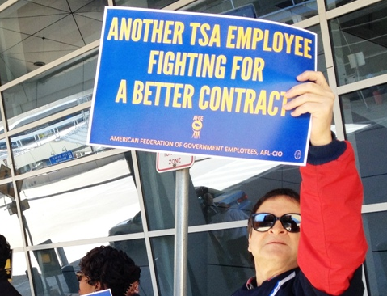
Mobilization

Slide 125
Your Local
What is a one major issue that your members are, or should be, worried about?
Why?

Slide 126
Issue Mobilization
Describe 3 specific ideas to mobilize employees around this issue.
Identify the resources that the Local will need to be successful.

Slide 127
Mobilization
3-2-1
Identify 3 ways to keep employees informed about what the Local is doing
List 2 methods the Steward can use to get feedback from employees on current worksite problems, concerns, and celebrations
Describe 1 strategy to encourage Union involvement

Slide 128

Organizing

Slide 129
Local Union Best Practices
One advantage of a large membership
One disadvantage of a small membership

Slide 130
Steward as Organizer
The reason most non-members give for why they are not a member is that no one talked to them about the Union or told them why they should join.

Slide 131
Why Employees Don’t Join (CESS)
Cost
          Experience
      Status
  Security

Slide 132

Getting Closer
The Art of Face to Face
(Role Play)

Slide 134

Official Time and the Union Steward

Slide 135
Official Time under the Statute
5 USC Section 7131
Any employee representing an exclusive representative in the negotiation of a collective bargaining agreement under this chapter shall be authorized official time for such purposes, including attendance at impasse proceeding, during the time the employee otherwise would be in a duty status. The number of employees for whom official time is authorized under this subsection shall not exceed the number of individuals designated as representing the agency for such purposes.

Slide 136
Official Time
The law requires that the amount of time that may be used be limited to that which the labor organization and employing agency agree is reasonable, necessary, and in the public interest.
As pointed out in a Congressional Research Service report, “(a)ny activities performed by an employee relating to the internal business of the labor organization must be performed while in a non-duty status.”

Slide 137
Official Time - Permitted representational activities are limited to:
Representing bargaining unit employees
Negotiating collective bargaining agreements
Enforcing law, rules and regulations, and CBAs.
Providing workers with a voice in determining their working conditions

Slide 138
Official Time Activities (Permitted)
Setting procedures that protect employees from on-the-job hazards, such as those arising from working with dangerous chemicals and munitions
Participating in improvement of work processes
Creating fair promotion procedures that require that selections be based on merit, so as to allow employees to advance their careers
Establishing flexible work hours that enhance agencies’ service to the public while allowing employees some control over their schedules

Slide 139
Activities which may not be conducted on official time include:
solicitation of membership
internal union meetings
elections of officers
any partisan political activities

Slide 140
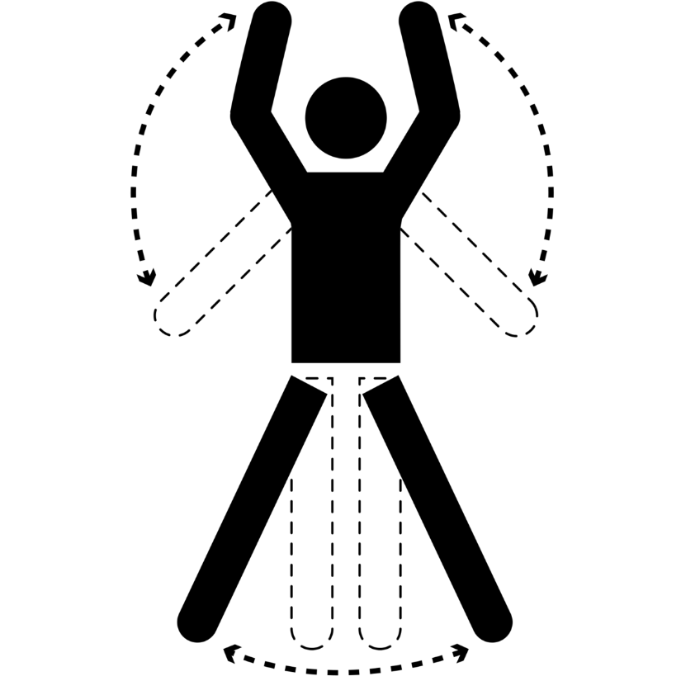
Exercise:
Official Time Scenarios

Slide 141
OFFICIAL TIME- Scenario 1
Andrea, a steward for Local 12300, has been asked to investigate a water leak that is affecting three employees on the 3rd floor. The supervisor stated that he would address the issue two weeks ago but nothing has happened.
Can Andrea use official time to investigate this issue?

Slide 142
OFFICIAL TIME- Scenario 2
Barbara, a steward for Local 32100, wants to set up a meeting with two other stewards to create campaign materials for the Local President reelection.
Can Barbara use official time to develop campaign materials for the Local President’s reelection?

Slide 143
OFFICIAL TIME- Scenario 3
Latisha, a steward for Local 11100, has received a request to attend a meeting with Hector Ramirez and his supervisor. Hector’s boss wants to ask him questions about a recent project that received negative comments from headquarters.
Can Latisha use official time to attend the meeting with Hector?

Slide 144
OFFICIAL TIME- Scenario 4
Tony, a steward for Local 22200, received an email from employee on another shift that were interested in learning more about the union. Tony wants to use official time for meeting with the employees after his regular shift has ended.
Can Tony use official time to attend the meeting?

Slide 145
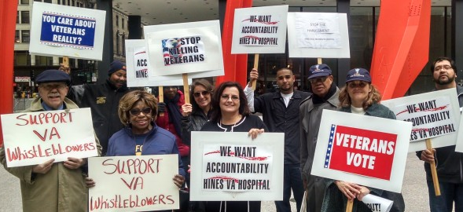
LEGISLATIVE AND POLITICAL MOBILIZATION

Slide 146
Legislative and Political Action
  AFGE, as a federal union, has rights to protect employees under current laws such as 5 U.S.C. Chapter 71.
  Worker rights are controlled by politicians who can protect or eliminate these laws.
  Inaction will eliminate our rights.

Slide 147
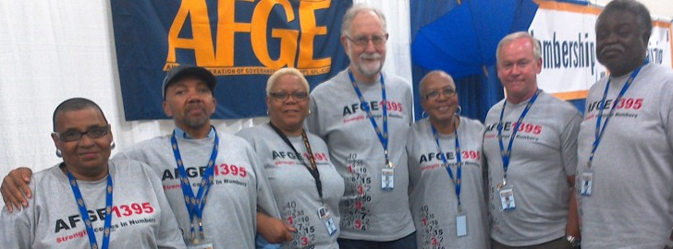
Stewards are the front line Mobilizing employees to fight for their rights!

Slide 148
Skills needed for successful legislative and political mobilization
  Differentiate between legislative and political activities.
  Identify ways to get members more involved in the legislative process.
  Determine if a situation is a violation of the Hatch Act

Slide 149
Legislative vs Political Activities
Legislative = governing
  Issues Proposed law
  House & Senate bills
Political = elections
  Candidates
  Political parties
  Fundraising

Slide 150
Member Involvement
What challenges could you face in getting members involved with legislative and political activities?
What are some ways to overcome these challenges?

Slide 151
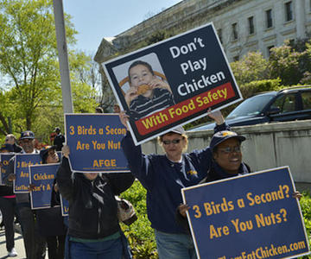
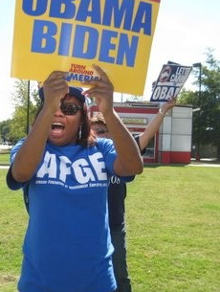
Legislative & Political Mobilization and the Hatch Act

Slide 152
Hatch Act Guidelines
OK
Issue and legislative activity
Personal actions away from government facility or identification
Non-partisan political activity (not related to any party)
PAC fundraising
Not OK
Candidate and election activity
Government duty time, facility, or identification
Partisan campaigns (party affiliated)
Candidate fundraising

Slide 153
Hatch Act DO’s and DONT’s
Employees May:
1. Register and vote as they choose;
2. Assist in voter registration drives;
3. Express opinions about all candidates and issues, privately and publicly;
4. Run for election to a non-partisan office;

Slide 154
Hatch Act DO’s and DONT’s
Employees May:
5. Contribute money to political organizations or attend a political fund raising function;
6. Sign petitions, including nominating petitions;
7. Wear political badges or buttons (except in government buildings or on uniforms);
8. Run for office within party organizations and affiliate groups;
9. Attend political conventions, rallies and meetings as an elected representative of a
partisan organization;

Slide 155
Hatch Act DO’s and DONT’s
10. Take an active part in political management of campaigns;
11. Solicit contributions to the political action committee of the organization to which employees belong provided that the contributor is not a subordinate employee;
12. Conduct voter registration drives on-site prior to AFGE’s endorsement of a candidate.

Slide 156
Hatch Act DO’s and DONT’s
Spouses and other members of an employee’s family may engage in all forms of partisan political activities.
Non-federal unions in the private sector are not covered by the Hatch Act.

Slide 157
Hatch Act DO’s and DONT’s
Employees May Not:
1. Be candidates for public office in partisan politics;
2. Use their official position to influence or coerce colleagues or election results;
3. Wear partisan political buttons or stickers while on duty;

Slide 158
Hatch Act DO’s and DONT’s
Employees May Not:
4. Collect, solicit, receive, handle, disburse or account for contributions from the general public (NO FUNDRAISING);
5. Wear a government uniform or government insignia while engaged in political activities;
6. Sell tickets to a political fund raising function to the general public;
7. Use government equipment such as email for political activities.

Slide 159
Exercise:
Hatch Act Scenarios

Slide 160
HATCH ACT - Scenario 1
You have a conversation with another AFGE member in the lunchroom about how budget cuts are undermining the Agency. You ask the member, who works in a different part of the facility, to speak with other co-workers about opposing H.R. Bill 1001 which will cut the Agency’s budget by 10%.
Question 1: Is this acceptable under the Hatch Act?
Question 2: Are there any guidelines or restrictions that may affect this action?
Question 3: What other actions could the member take to help fight against H.R. Bill 1001?

Slide 161
HATCH ACT - Scenario 2
You are talking with several people at work about how the agency is getting less effective and a co-worker suggests that the Union send a letter to the congressional representative requesting that the Secretary of the Department reconsider several cuts to agency staffing. Another co-worker recommends inviting the congressional representative to meet with the union at the facility to discuss their concerns.
Question 1: Is this acceptable under the Hatch Act?
Question 2: Are there any guidelines or restrictions that may affect this action?
Question 3: What other actions could the Local take?

Slide 162
HATCH ACT - Scenario 3
An AFGE member invites several co-workers in the department out for a happy hour event at a local tavern. One of the Local VPs is also invited. At the happy hour, the conversation gets into politics, which ends in the VP asking the dozen or so employees who are there to “do what you can and volunteer to help elect Sue Mallory!’ Sue Mallory is a candidate for the 3rd District Congressional seat. The outburst was then followed by a round of drinks to toast the candidate.
Question 1: Is this acceptable under the Hatch Act?
Question 2: Are there any guidelines or restrictions that may affect this action?
Question 3: What other actions could the Local take?

Slide 163
HATCH ACT - Scenario 4
The U.S. presidential election is underway and the AFGE Executive Board has endorsed a candidate. Your Local votes to hold a voter registration drive in the cafeteria every month until the election.
Question 1: Is this acceptable under the Hatch Act?
Question 2: Are there any guidelines or restrictions that may affect this action?
Question 3: What other actions could the Local take?

Slide 164
2 Key Rules to Remember
# 1 - You may pursue legislative activity on official time (if provided by your contract) and on site (if not prohibited by your contract), but you may not perform political or electoral work on site or on official time.
# 2 - You may solicit financial contributions to the AFGE PAC off-site only and you may only ask other AFGE members to give.

Slide 165
Review and Wrap Up

Slide 166
Course/Instructor Evaluation

